Slide 1
AVD Campus Fabric Testing
Brian Hayes

Slide 2
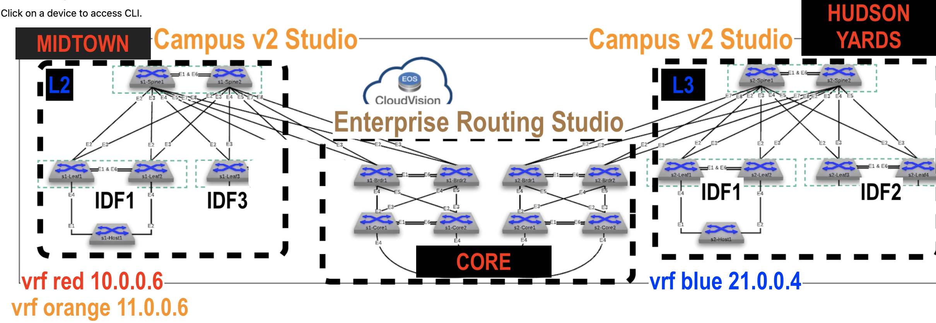
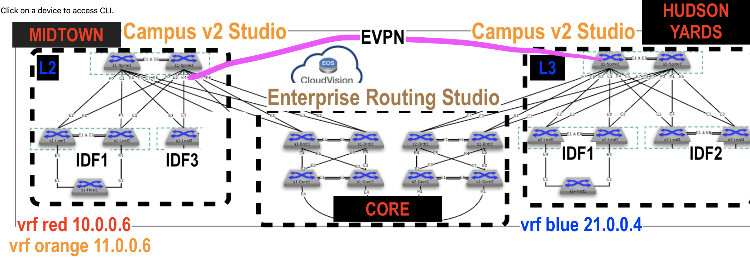
ATD Test Setups
1.End to End BGP
2.End to End BGP w EVPN
3.End to End OSPF
4.End to End OSPF w EVPN

Slide 3
End toEnd BGP

Slide 5
End toEnd BGP

